Slide 1

SILVER OAK COLLEGE OF COMPUTER APPLICATION

Slide 2
NAME : PADHIYAR ARYA K.
ENROLLMENT NO. : 2204030102099
Project Guide : PARTH PADHIYAR
SEMESTER : 2
CLASS : M1 A4
Subject name : Internship OGT

Slide 3
PROJECT - CARE
NAME NOW

Slide 4

HOME PAGE

Slide 5
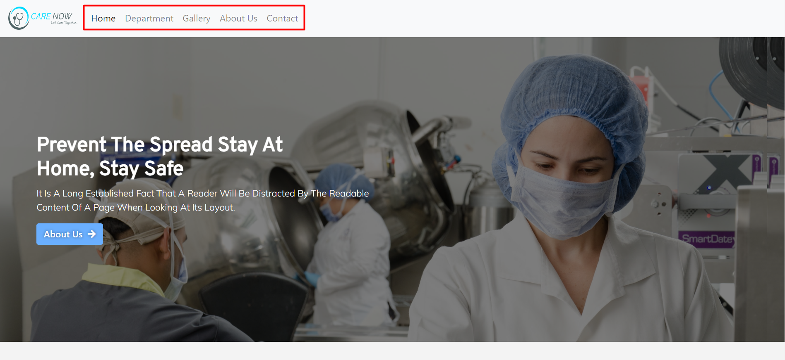
header

Slide 6
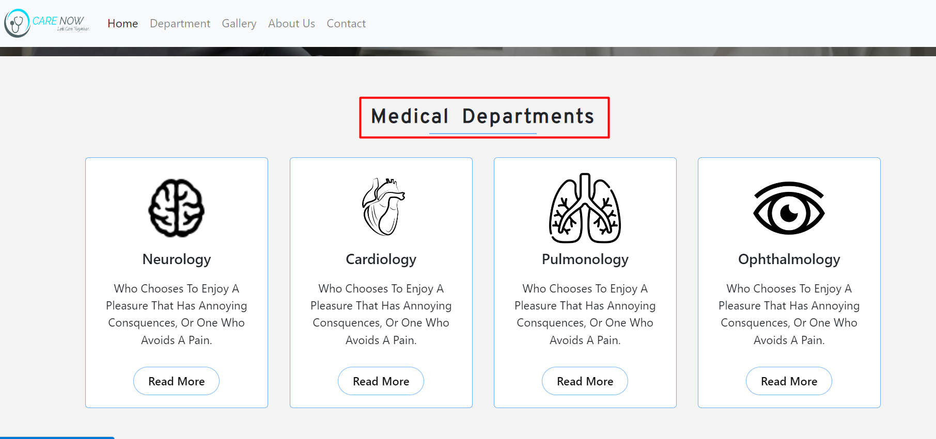
Different departments

Slide 7
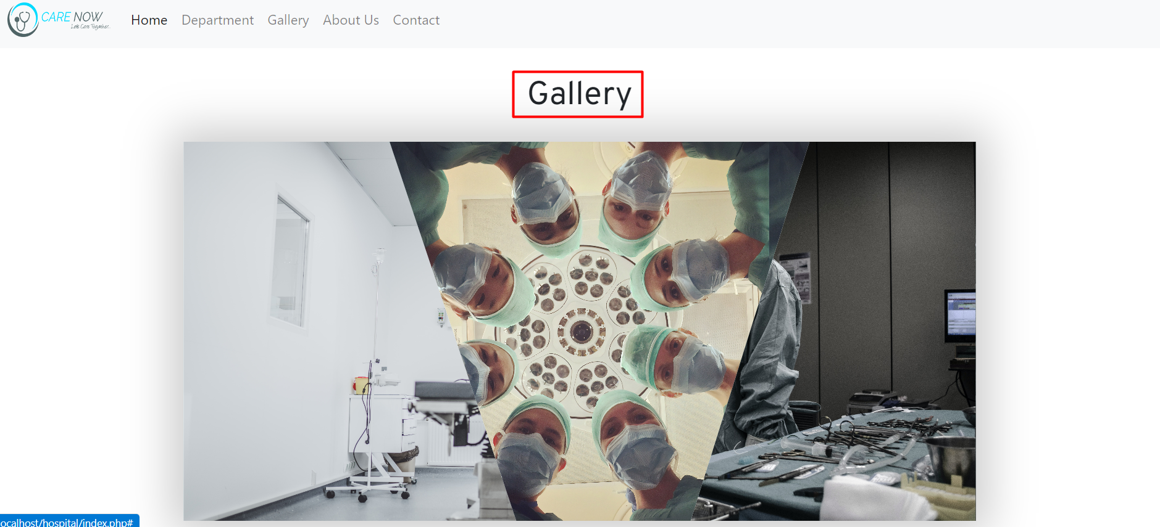
GAllery

Slide 8
OUR different medical departments

Slide 9

Anaesthesiology

Slide 10

Brain surgeon

Slide 11

heart surgeon

Slide 12
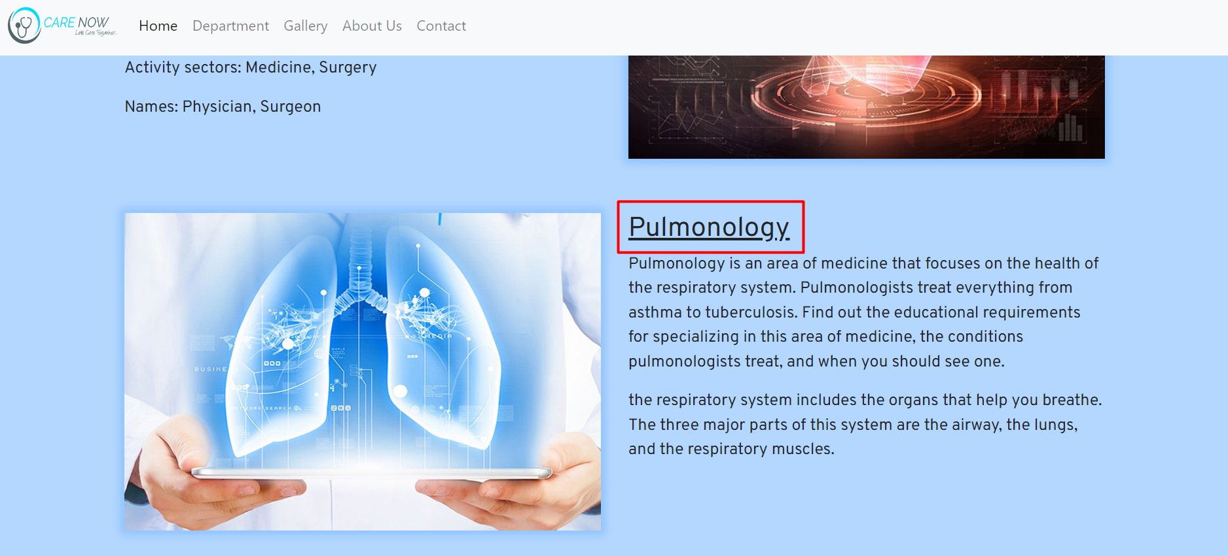
Lungs surgeon

Slide 13
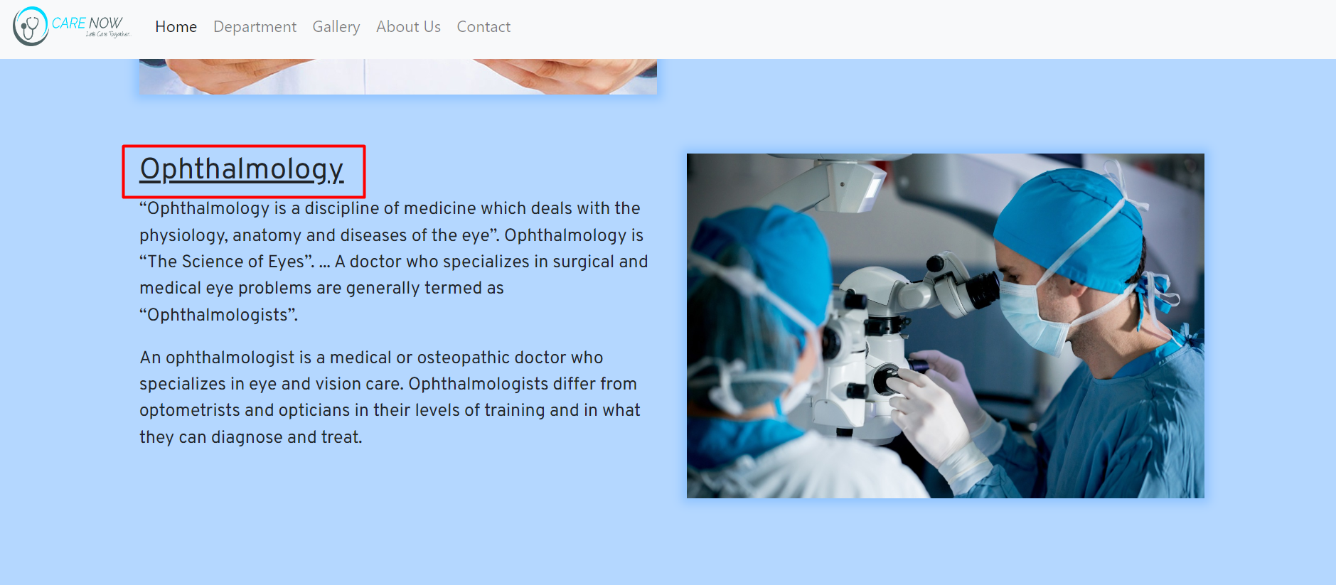
Eye surgeon

Slide 14
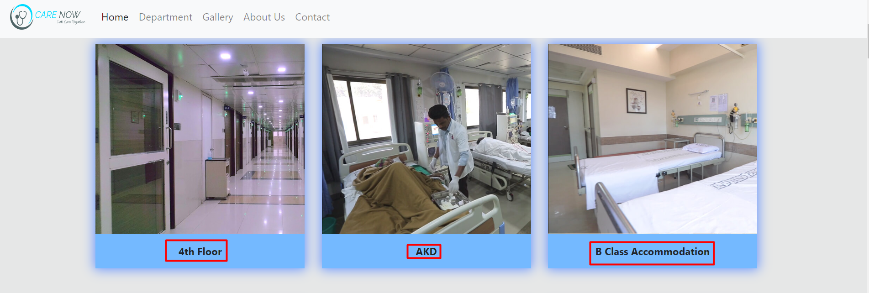
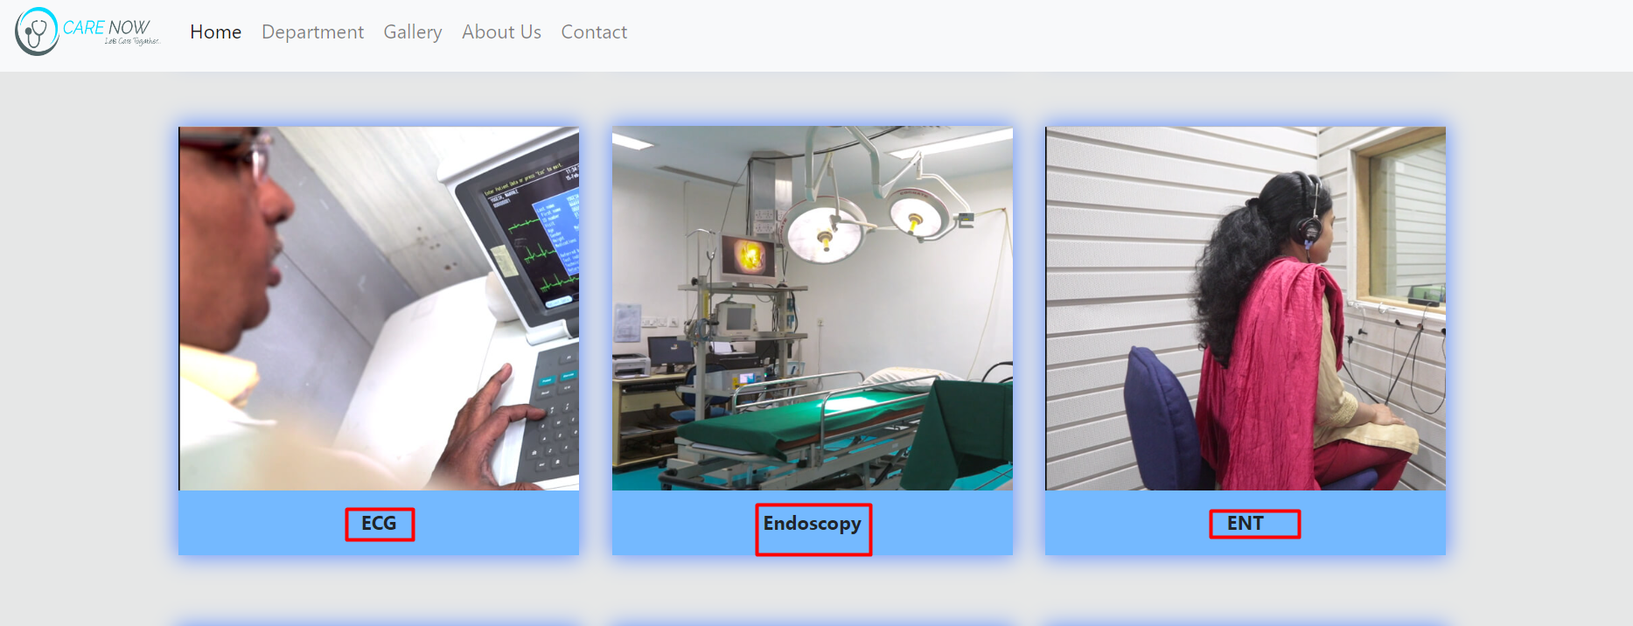
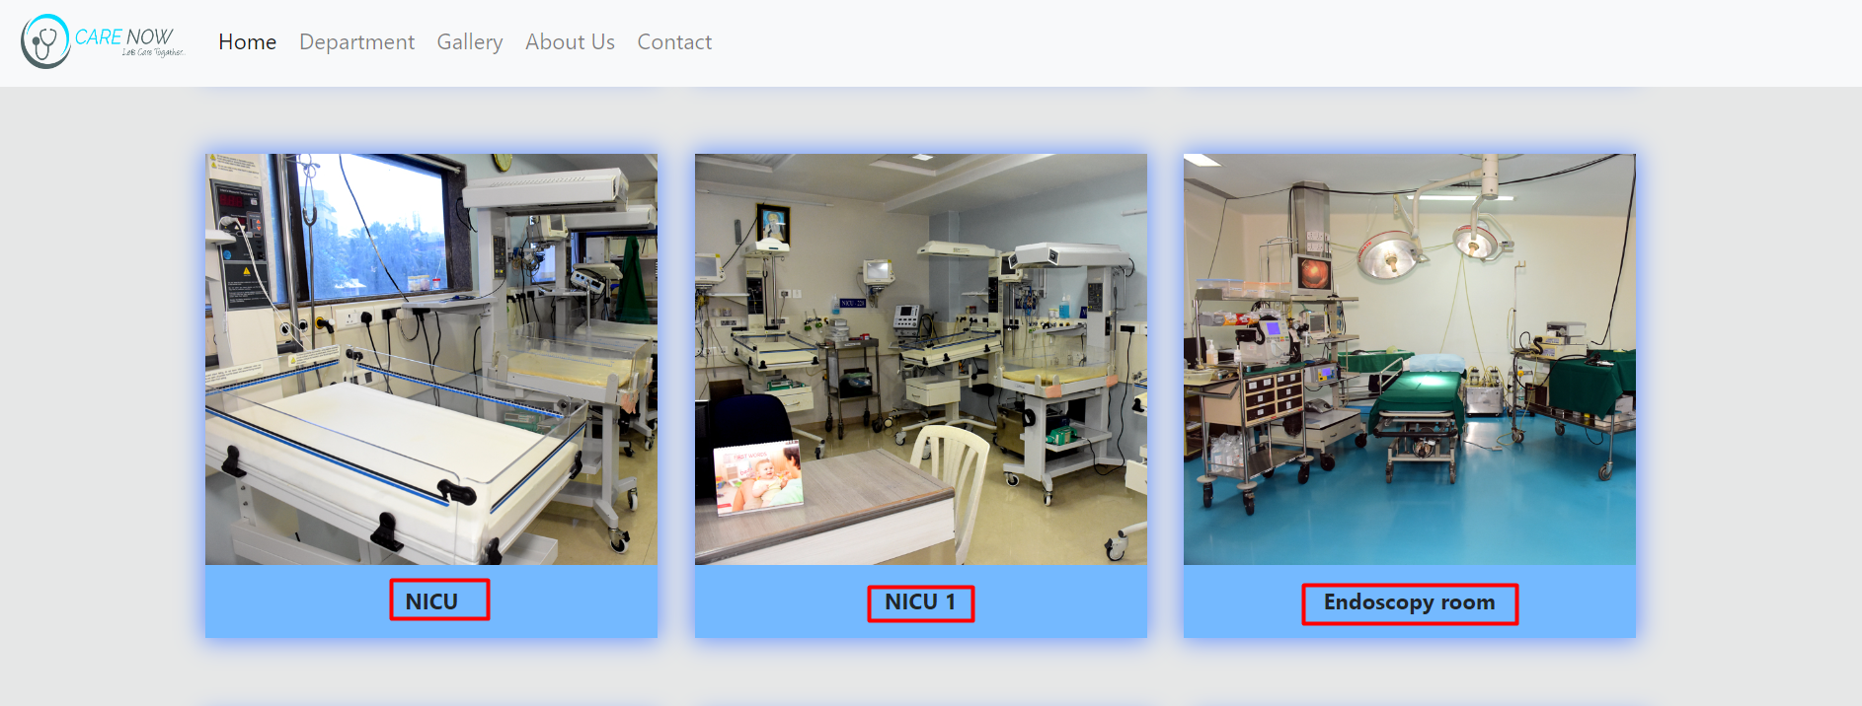
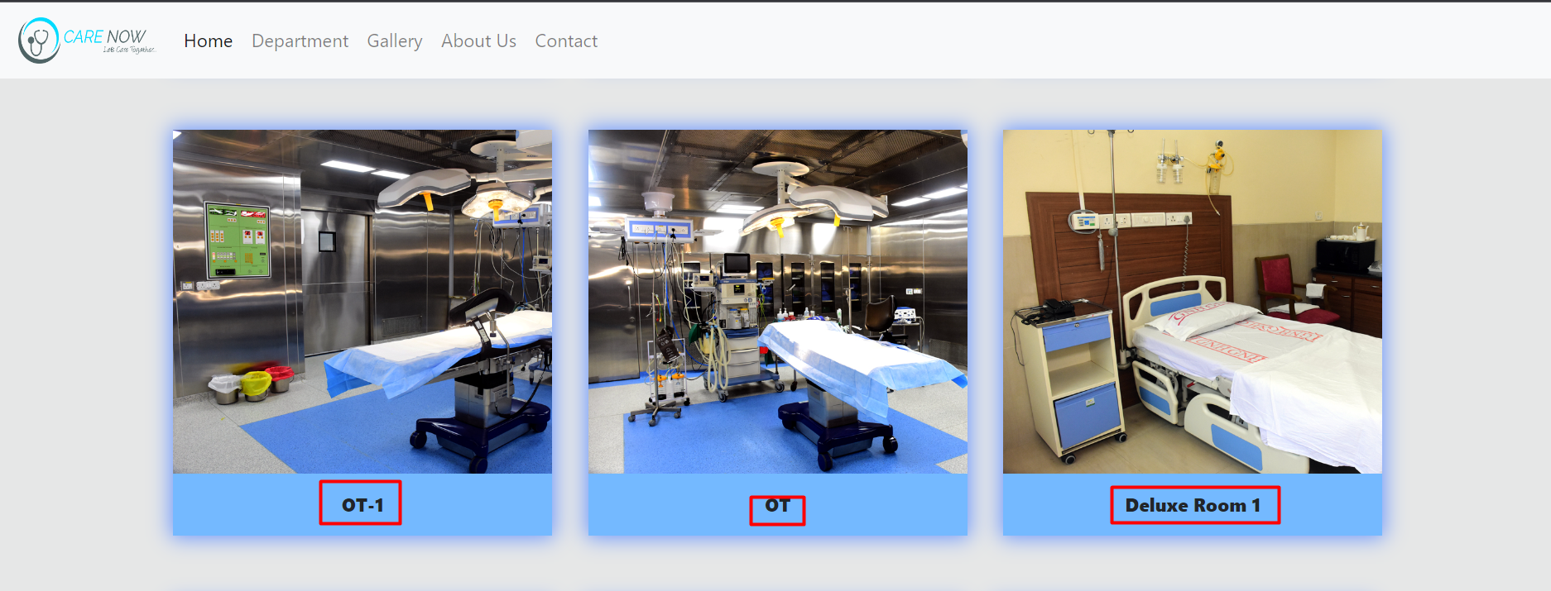
Our services

Slide 15


description

Slide 16
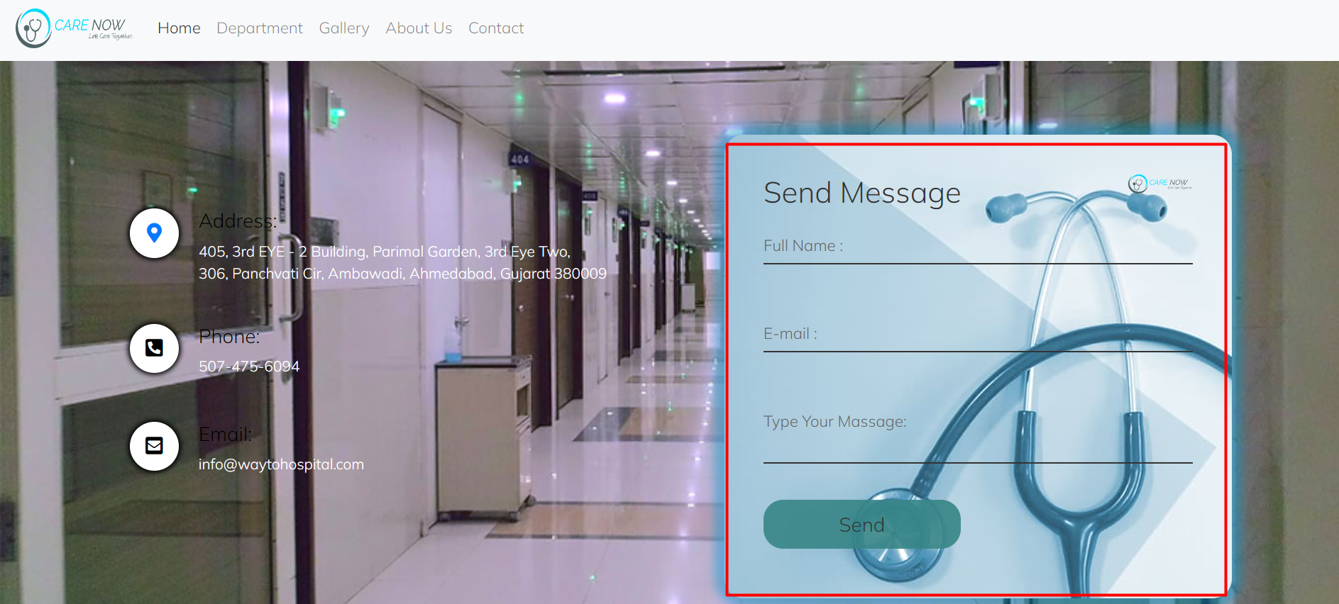
Contact us

Slide 17
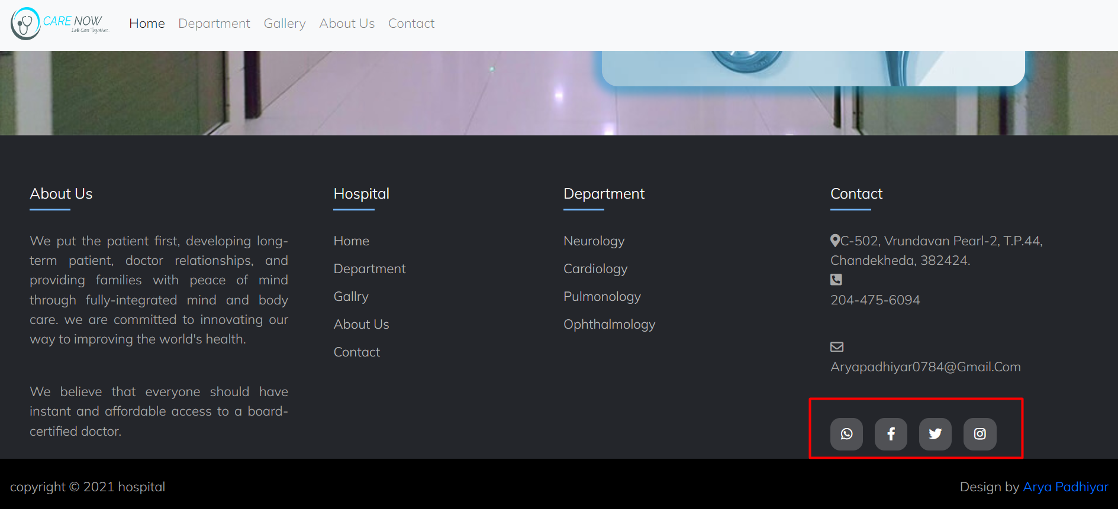
Social media link

Slide 18

footer

Slide 19
conclusion
The good implementation of the project has great significance to the expansion of the organization through different types of advertisements .

Slide 20
Thank you…!!

Slide 21
Silver oak college of computer application

